Slide 1


Big Mart Sales data
Focus Points for Marketing to increase overall sales
Notes:
Good afternoon ladies and gentlement. My name is Howie and this is the rest of the in-house data science team. We were recently tasked to find the most valuable variables that correlate to increased sales at our store fronts to ensure our next store front or region we that tap into would provide a fruitful outcome. Through out this presentation, I will explain our analysis, findings, and any recommendations we have for years to come

Slide 2
Table of contents
Hypothesis
Exploratory Analysis
Findings
Recommendations
Notes:
T start we will initially present our hypothesis that was simply based on our educated guesses of what might be the biggest contributors just through eyeballing the data set, we will then dig into the exploration of the data that was provided to show any trends we found and how those might be key variables. after that we will present our findings that we attained from the model that we ran, and lastly, we will provide our recommendations for the next projects to come.

Slide 3
Hypothesis
Hypothesis: Either MRP or Item Visibility are going to have the biggest effects on Item Outlet sales
Notes:
When creating our hypothesis we approached it from a practical/realistic standpoint. We had the conversation of being at a storefront and thinking (as consumers and analysts) what are the biggest sales driven variables in this data set. What we decided was MRP was going to be the biggest contributor to sales, because just like most industries, rate is king. We then though Item visibility and item type would be the second biggest. Let’s see what our initial analysis shows us.

Slide 4
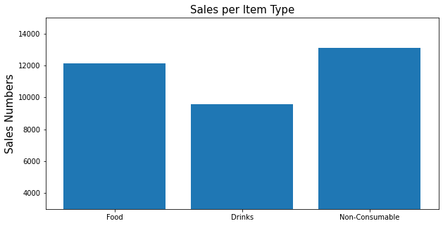
Exploratory analysis
Notes:
One of the first things I did was dig into the distribution of different types of items sold at Big Mart. This image shows us the distribution of sales numbers between each type of item sold through Big Marts Outlets. The data shows us that most of the items sold are non-consumables with food and drinks following respectively.

Slide 5
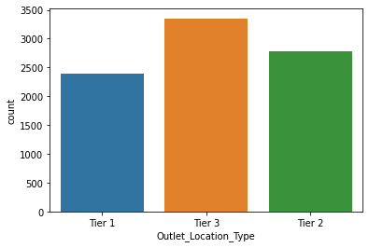
Exploratory analysis
Notes:
Next, we wanted to look at the distribution between store tier types. The data shows us that most of the location types are tier 3, so that's where most of the sales will be coming from. This is to be expected because larger stores will have more sales. Since most of our locations are larger, this won’t be an issue to focus on for improvement.

Slide 6
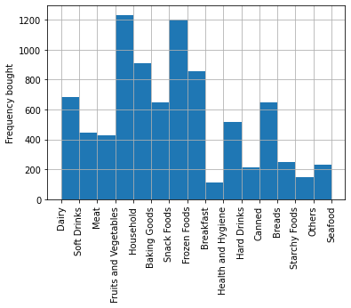
Exploratory analysis
Notes:
This bar graph shows us the distribution of the breakdown of each type of product sold and its corresponding sales data Fruits and vegetables as well as snack foods seem to be the most sold items in the outlets on average. On the lower end we have breakfast, hard drinks, and starchy food. As seen back on the previous slide, there is some room for improvement in oversales of beverages. Typically hard beverages bring in a significant amount of revenue, so we saw that as an area for opportunity.

Slide 7
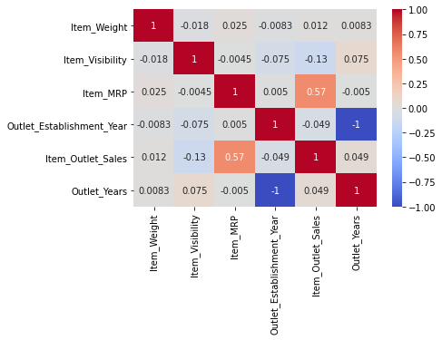
Exploratory analysis
Notes:
This heatmap shows the level of correlation between each variable. According to this heatmap, The highest correlated variable to our target variable, which is item sales, is the items MRP. This is followed by item weight and outlet establishment year. Based on this we decided to dive a little bit deeper on what we had originally hypothesized to see if there were any trends.

Slide 8
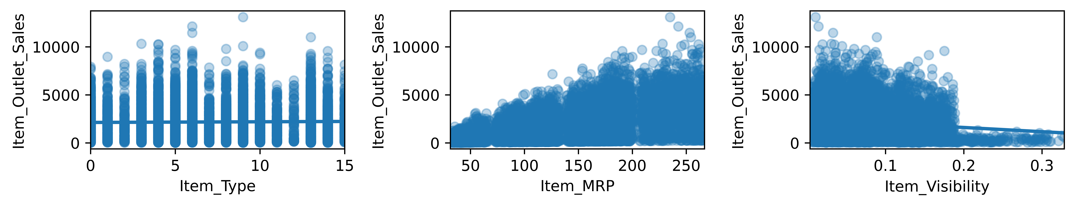
Exploratory analysis
Notes:
These images show the correlation between the 3 main variables we hypothesized to be the highest correlated to sales. From left to right, you can see that Item type has a pretty even distribution to correlation with sales overall, In the middle, Item mrp sales data correlation spikes signifigantly as the price of the item goes up. lastly Item visibility sales are higher as the visibility scale lowers. Once it hits 0.2 the data points go from slooping down, to pretty much dropping off hitting under the $1000 mark for sales. This shows us the importance of item visibility, and reiterates how big of a contributing factor it is to our goal of increased sales.

Slide 9
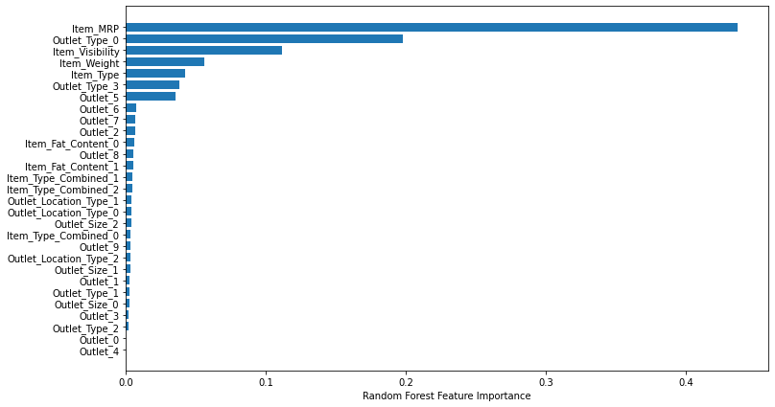
Findings
Notes:
After running the model, we’ve confirmed that Item MRP has the highest feature importance when trying to determine sales figures. This is followed by Outlet type, Item visibility, and Item weight respectively. For our analysis, to cleanse the data we had to break down categories into smaller categories to fit into our model. Even then, there is no broken down/combined variable that is close to the top 3. Next we will provide our recommendations of what we had found in our data.

Slide 10
Recommendations
Providing stores with higher priced items to attain additional sales
Having more expensive products be better visible through out the stores to increase the buyer’s chances of purchasing them
Increase marketing on beverages
Notes:
Since Item MRP has the highest correlation to increased sales, we recommend providing additional higher priced items at each of the stores. As mentioned earlier in the presentation, rate is king. We recommend doing this in tandem with the second highest relative variable, which is item visibility. Improved product placement of high-ticket items through out the store will increase shoppers chances of seeing that item, and making the decision to purchase it.
Based on our initial analysis, we also recommend increasing marketing efforts of beverages. This seems to be the laggard of the 3 categories of items sold at our stores, and it is one of the easiest items to advertise. This can be done by product placement in strategic parts of the store, as well as having additional advertising for those products throughout.
Hopefully you all find these recommendations useful for the next project. Please reach out with any questions or ask about any additional information we didn’t cover in this presentation. Thank you!

